Slide 1
COMPASS
Scoring 1.01

Slide 2
Agenda
Introduction
Architecture
Basic Procedure
When Things Go Wrong
Tips & TakeAways
Room Set-up & Score Corrections (pm)

Slide 3
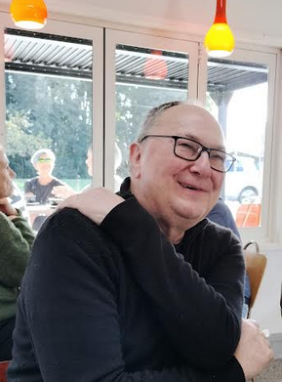
OUR BOB
Started writing Compass 45 years ago in Tokoroa
Moved to seattle in 2000
Hadn’t played since moving
Knows all about bridge in nz
Apart from a token 1-off licence to use compass has Never charged for his work
Is 70% through a rewrite of compass in visual basic.net - Slated for release in 2026

Slide 4
A Crossroads
The soon-to-be-old compass v6
The new compass vb.net
Going to show some Comparisons side-by-side

Slide 5
Architecture 1
Five elements – three software, two hardware - Compass, Compassmate, BCS, Server, Table-Top Units (TTU’s)
Bridgemate Control Software (BCS) interfaces TTU’s with Server and opens a Microsoft Database .bws template as instructed by Compass
Scorer sets up session
Compassmate opens and populates .bws mdb with movement data
Server reads/writes .bws as it sends/receives data to/from the TTU’s
Compassmate reads the .bws while it is active
Compassmate passes its data to Compass upon closing

Slide 6
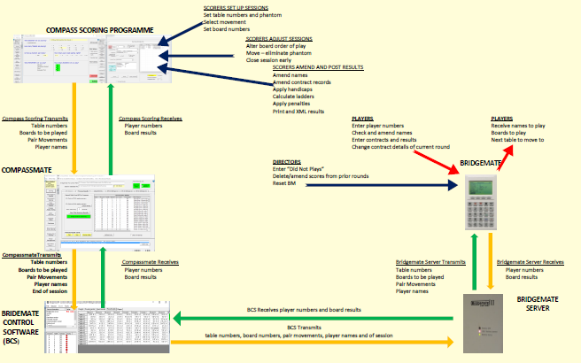
Compass/bridgemate system architecture

Slide 7
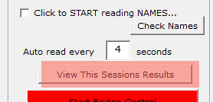
Architecture 2
Open Compassmate with Open/Return to Compassmate
Close Compassmate with View This Sessions Results
… think of these things as of a drawbridge

Slide 8
Basic Procedure 1
Movement defined and loaded to BCS when Compassmate is first started
If using Bridgemate TTU’s need to tick Start Reading Names/Scores – automatic with BridgePal tablets. Then click Start Bridge Control (but not if it’s green) (seek help)
Normal for nothing to do until end of session – Entry Status is empty of expected results. Start button goes red 20-30 seconds after last BM activity
View This Sessions Results takes you back to Compass – the Results screen
Check all pairs have played the expected number of boards – any TBA advice?
Check for Suspicious Scores or Bad Names before printing or publishing especially if you are running Compa$$. There are WARNINGS!!

Slide 9
Basic Procedure 2
Handicaps will be applied automatically if a list is defined. A list can be chosen under Options (are you using XG handicaps – if not why not?)
Print both Raw and Handicapped Results (both on a single A4 if < 5 tables)
Publish to your website results page – check – got the correct hands?
Update and post Competition Ladder
(Post to Compa$$ - check correct director if paying them)
… what could go wrong???

Slide 10
COMPASS
Scoring 1.02
.. When things go wrong!!!

Slide 11
Common occurrences 1
BCS still running from previous session? Kill Invisible Session
Hand Records Not Visible to Players
Restarting a Session – late arrival? Miscounted tables? Phantom?
Truncating a Session
Lots of TBA’s in Results/Scores screens - Re-read Names/Scores
Correcting Names, substitutions in Teams and Swiss Pairs
Correcting Scores (Score Adjustments to be covered in afternoon)

Slide 12
Common occurrences 2
Handicaps Missing
Results not Posting to Website – ShipResults
Simulations
Import Log File
Wrong file chosen – previous one overwritten
Recover files from Dropbox Activity
.bws incomplete? - re-send results from TTU’s

Slide 13
TIPS & TAKEAWAYS
Reboot computer at least weekly and always before a tournament
Don’t be scared of “funny movements” – players come to prefer them
Read up the Help. Prepare & practice using simulations (even at home) Ask for a Home Copy of Compass – the more the merrier
Hold off starting Bridge Control until all boards are laid out and instructions are double-checked – esp for Movement Impaired
Allow time for dropbox to synch before turning computer off
Small group of the experienced vs lots of novitiates?
Everyone stuffs up!
Seek help if unsure
Learn from your mistakes
Persevere

Slide 14
COMPASS
Scoring 1.03
Room set-up and use of sam

Slide 15
room Set up
Director’s job, really. Scorer informs the Director
Recommend you always to work with SAM (Scoring Assist Mode)
Let’s look at scoring set-up in V6 then in VB.Net
In V6 ClubInfo SetUp (CISU) Club Options 1 set SAM to auto-open
Can toggle between SAM and Detail Set-Up in V6, tab in VB.Net
Must use Detail Set-Up for tournaments or multi-section events
… but still extremely valuable to form a plan with SAM

Slide 16
Scoring assist mode (sam)
Defaults to the day’s session(s)
Three simple questions to answer:
How many tables?
Is there a Phantom?
(How many fixed positions?)
A selection of bomb-proof movements is offered
Why (why not) SAM?
Avoids multiple sit-outs
Avoids pairs meeting again
Avoids truncated sessions
Positions phantom and stationary pairs to best effect
All you need do is COUNT the tables (accurately) and FOLLOW the guides

Slide 17
The Movement-impaired
The well-spring of SAM
Take EXTRA care (as in double-check) that MI’s don’t have to move
Tip – nothing much happens at Tables 2-4 .. except in Howells
Can nominate supplementary fixed positions in Compassmate - example
Don’t be scared of “funny movements”. Players will come to prefer them once they get used to them. Have you tried asking for volunteers to sit out for two rounds .. or maybe your people like having 5-board sit-outs?

Slide 18
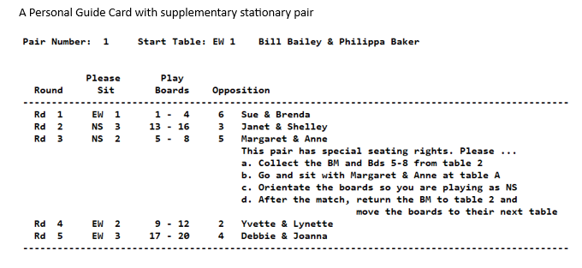

Slide 19
COMPASS
Scoring 1.04
Scoring Adjustments

Slide 20
Technical adjustments
Beyond the simple DNP, Passed In, 60-40 sort of thing
Director’s adjustment to a pair’s total
Pairs sitting in the wrong direction in, eg, a Howell
In V6 ClubInfo SetUp (CISU) Club Options 1 set SAM to auto-open
Can toggle between SAM and Detail Set-Up in V6, tab in VB.Net
Must use Detail Set-Up for tournaments or multi-section events
… but still extremely valuable to form a plan with SAM

Slide 21
THANK YOU
Mike Neels
021 179 7686
quidge15@gmail.com

